Slide 1

AUTOMATED AND SEMI-AUTOMATED ARCHITECTURE FOR GATHERING INTELLIGENCE USING DIFFERENT DATASETS
Group members:-
AADEESH BALI (21101)
ADITI MULAY (21103)
ANIKET BHAGWAT (21109)
SAMEER BRAMHECHA (21115)
DEVANSH CHOUDHURY (21122)

Slide 2
Introduction
For developing a mechanism to protect and secure the cyber world, our little step is towards beginning a process of developing prototypes for guarding not only assets but also civilians. Here we have first worked on automated, and then semi-automated prototypes. Automation, from the word we can understand it can operate freely without any human intervention. Now same goes with the semi-automation, from the word we can understand it is partially automated and have human interference in it. We will see further in the implementation section how these prototypes will perform. Nowadays, a lot of people use social network sites like Facebook, Twitter, Google Plus, LinkedIn, etc. to express their emotions and share views about their daily lives. Through these online communities, we get an interactive media where consumers inform and influence others through the forums. Social media is generating a large volume of sentiment rich data in the form of tweets, status updates, blog posts, comments, reviews, etc.

Slide 3
Motivation
There are many people in this world who are thinking to end their life, due to their negative thinking. There may be some solution on their problem due to which they are going to end their life, but they are not sharing with anyone else. Some of them are posting such type of negative text on twitter. So, we are aiming to help such people identify their sentiments and accordingly it would help them to improve on it.

Slide 4
SCOPE OF THE PROJECT
Our team aims to create a tangible model that can be adapted to various data sets and be used in an efficient manner. We mainly focus on tweets as a form of data input to sort out various sentiments- positive or negative. Currently, this being implemented on a small scale, we aim to take it even further. The model can be further trained to analyze and gather the required information from different datasets having different origins.

Slide 5
Literature Survey
1. MACHINE LEARNING: -
Arthur Samuel, a pioneer in the field of artificial intelligence and computer gaming, coined the term “Machine Learning”. He defined machine learning as – “Field of study that gives computers the capability to learn without being explicitly programmed”. In a very layman manner, Machine Learning (ML) can be explained as automating and improving the learning process of computers based on their experiences without being actually programmed i.e. without any human assistance.

Slide 6
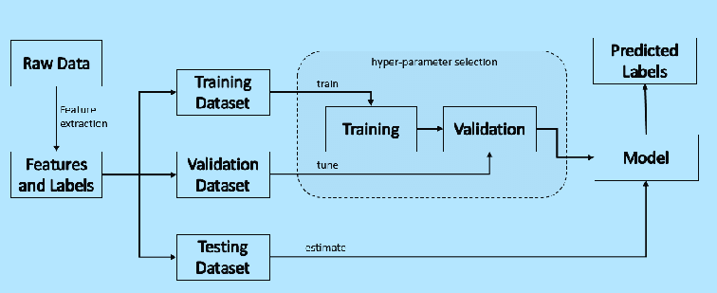

Slide 7
Literature Survey
2. NATURAL LANGUAGE PROCESSING: -
Natural language processing (NLP) refers to the branch of computer science—and more specifically, the branch of artificial intelligence or AI—concerned with giving computers the ability to understand text and spoken words in much the same way human beings can. NLP combines computational linguistics—rule-based modeling of human language—with statistical, machine learning, and deep learning models. Together, these technologies enable computers to process human language in the form of text or voice data and to ‘understand’ its full meaning, complete with the speaker or writer’s intent and sentiment. NLP drives computer programs that translate text from one language to another, respond to spoken commands, and summarize large volumes of text rapidly—even in real time.

Slide 8
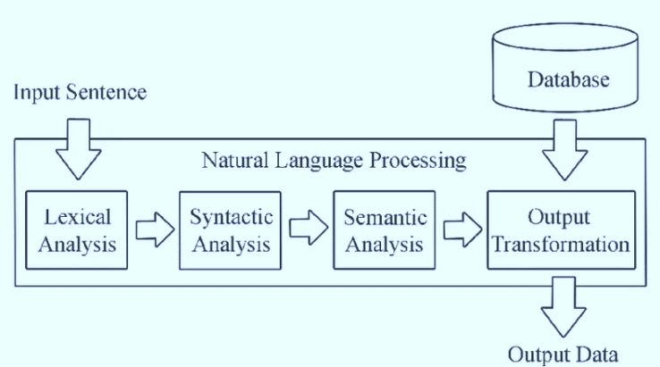

Slide 9
Literature Survey
3. SENTIMENTAL ANALYSIS: -
Sentiment Analysis is contextual mining of text which identifies and extracts subjective information in source material and helping a business to understand the social sentiment of their brand, product or service while monitoring online conversations. However, analysis of social media streams is usually restricted to just basic sentiment analysis and count based metrics. This is akin to just scratching the surface and missing out on those high value insights that are waiting to be discovered. With the recent advances in deep learning, the ability of algorithms to analyse text has improved considerably.

Slide 10

SOFTWATE REQUIREMENTS
Python 3.9 – Programming Language.
Anaconda – A distribution of python programming language for scientific computing.
PyCharm – Integrated Development Environment (IDE).
Jupyter Notebook – A software that allows to creation and sharing of documents that integrate live code.
Google Collaboratory – Google Collaboratory is a free Jupyter notebook environment that runs entirely in the cloud. Most importantly, it does not require a setup and the notebooks that you create can be simultaneously edited by your team members - just the way you edit documents in Google Docs.
Visual Studio Code - A code editor to be used for Web Development using HTML and CSS.

Slide 11

IMPLEMENTATION DETAILS
THE PYHTON LIBRARIES USED IN OUR PROJECT ARE: -
Pandas
NumPy
Spacy
Beautifulsoup
Flask

Slide 12
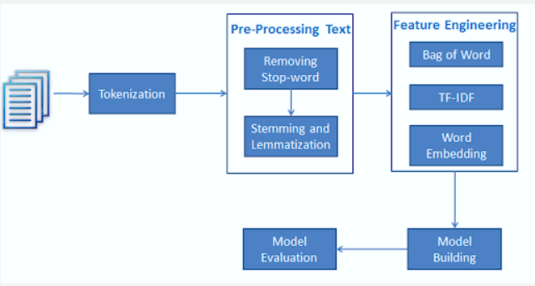

Slide 13
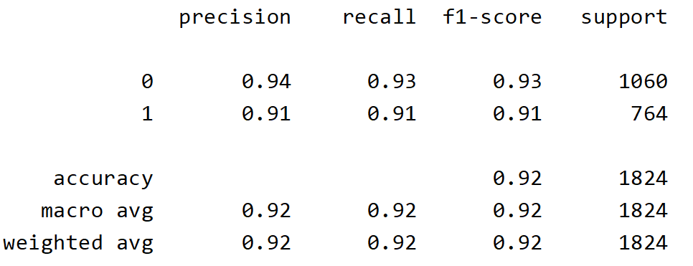
Accuracy of the model

Slide 14
Output of the Model

Slide 15
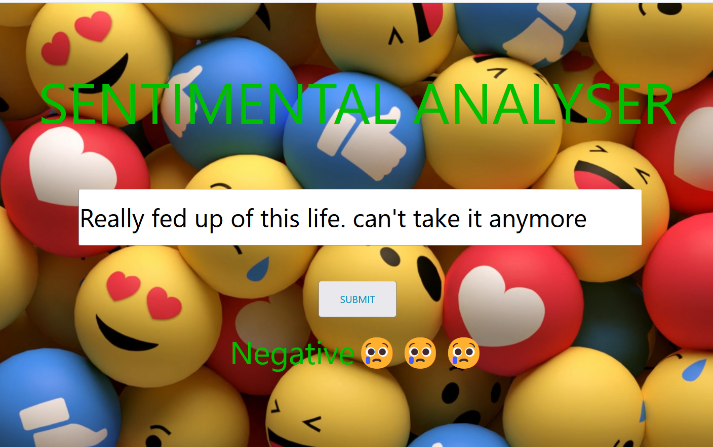

Slide 16
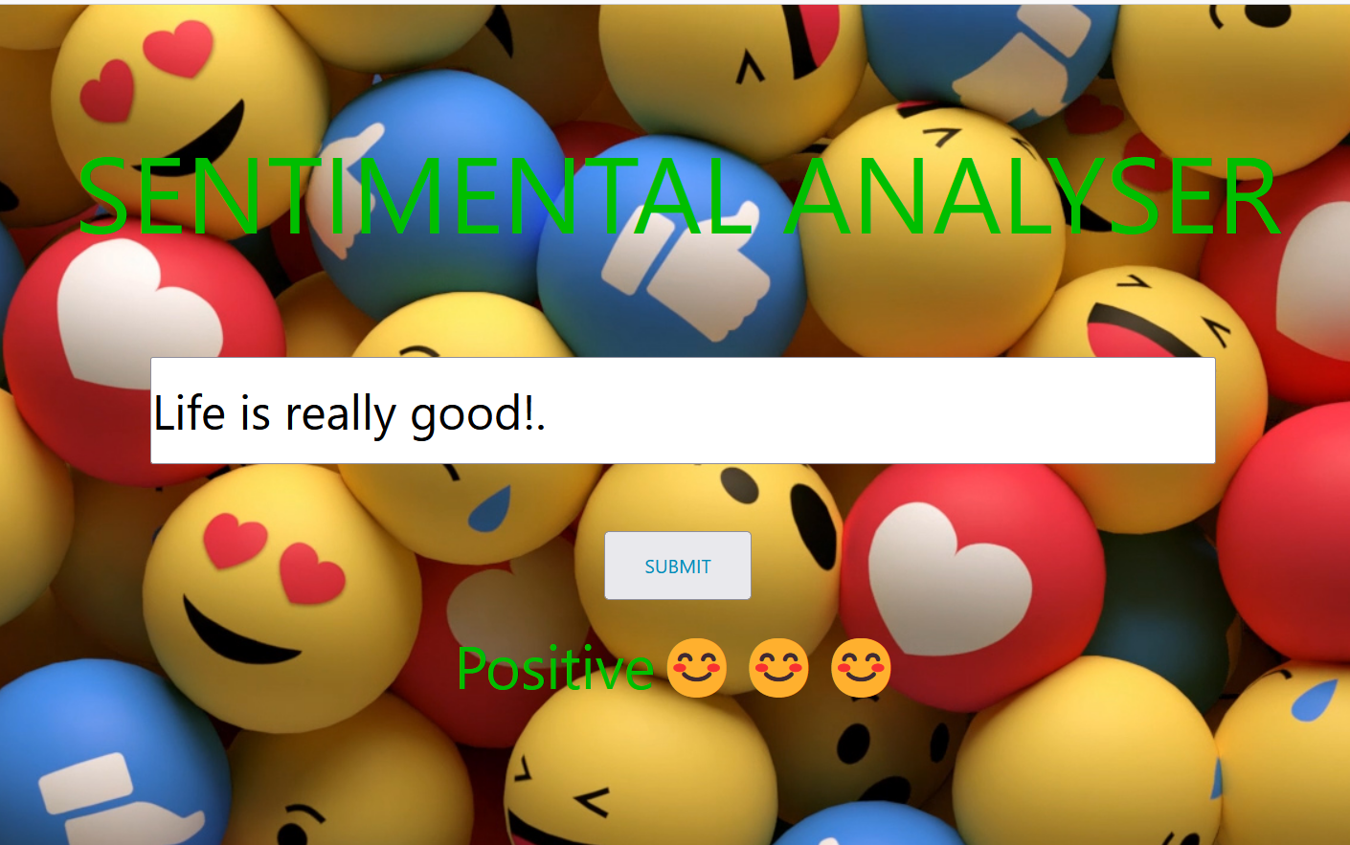

Slide 17

Thank you

